Slide 1

Exploring genome-wide organization of chromatin structure by ChIP-seq
Alon Goren
Department of Medicine,
UCSD

Slide 2
Outline
Introduction to chromatin organization
ChIP-seq (Chromatin ImmunoPrecipitation) sequencing
Analysis of the genomic organization of DNA associated proteins
Organization of chromatin regulators
An example study: Cooperative binding of TFs orchestrates reprogramming
Future directions

Slide 3
Outline
Introduction to chromatin organization

Slide 4
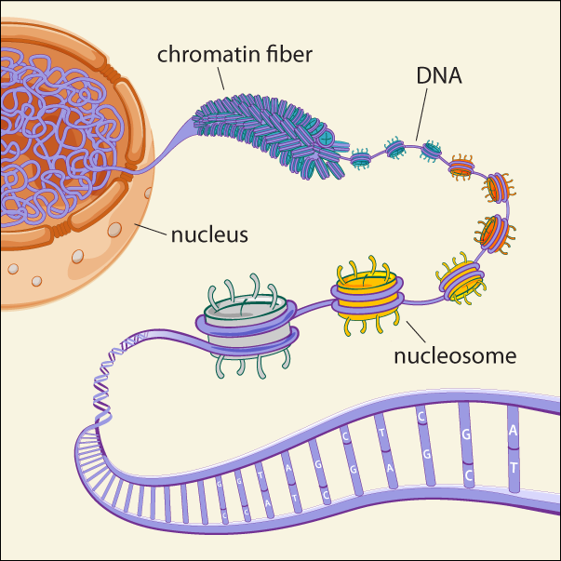
Chromatin Structure & Organization
nucleus
Broad Communications

Slide 5
Chromatin Structure & Organization
Broad Communications

Slide 6
Chromatin Structure & Organization
Broad Communications

Slide 7
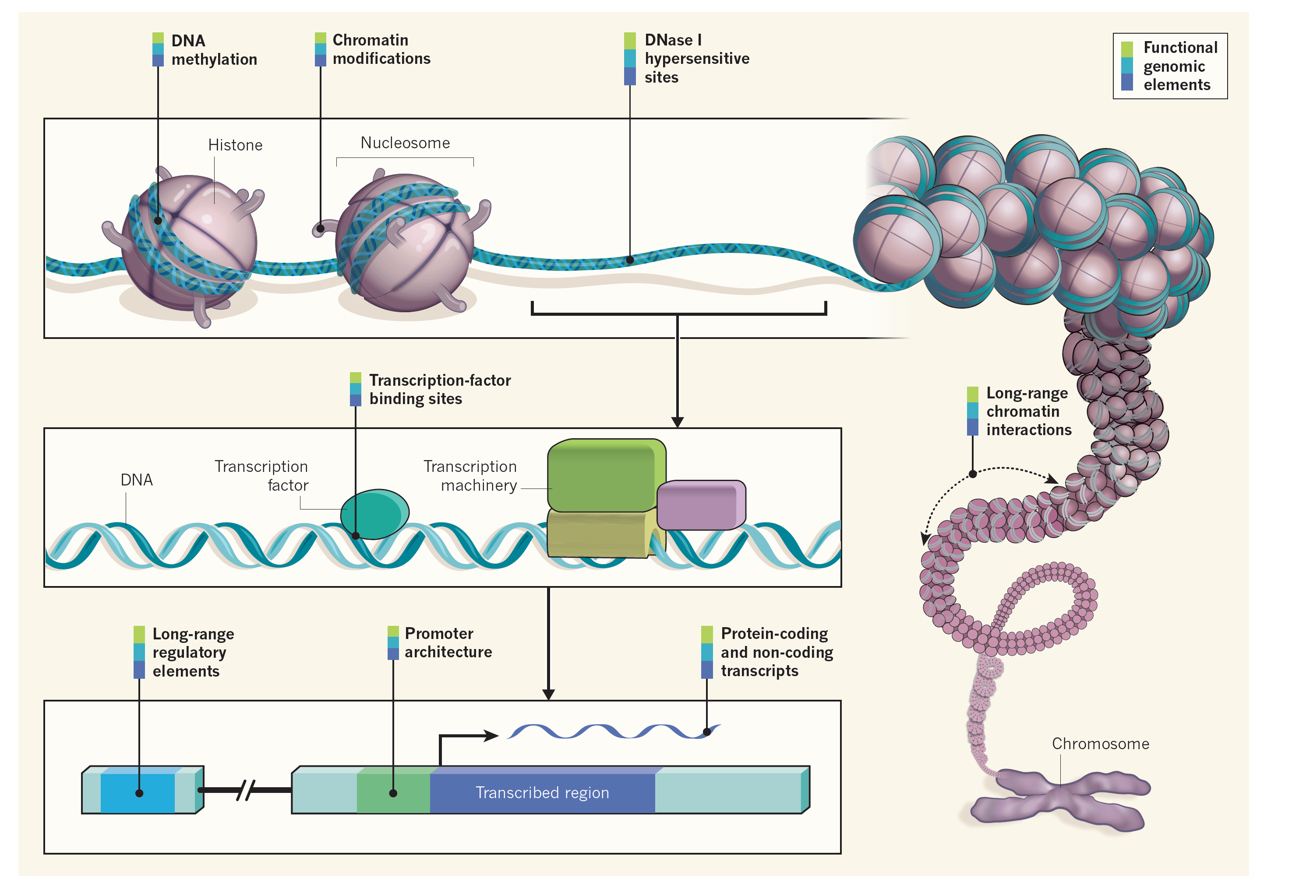
Study of Chromatin Structure & Organization
Ecker et al., Nature 2012

Slide 8
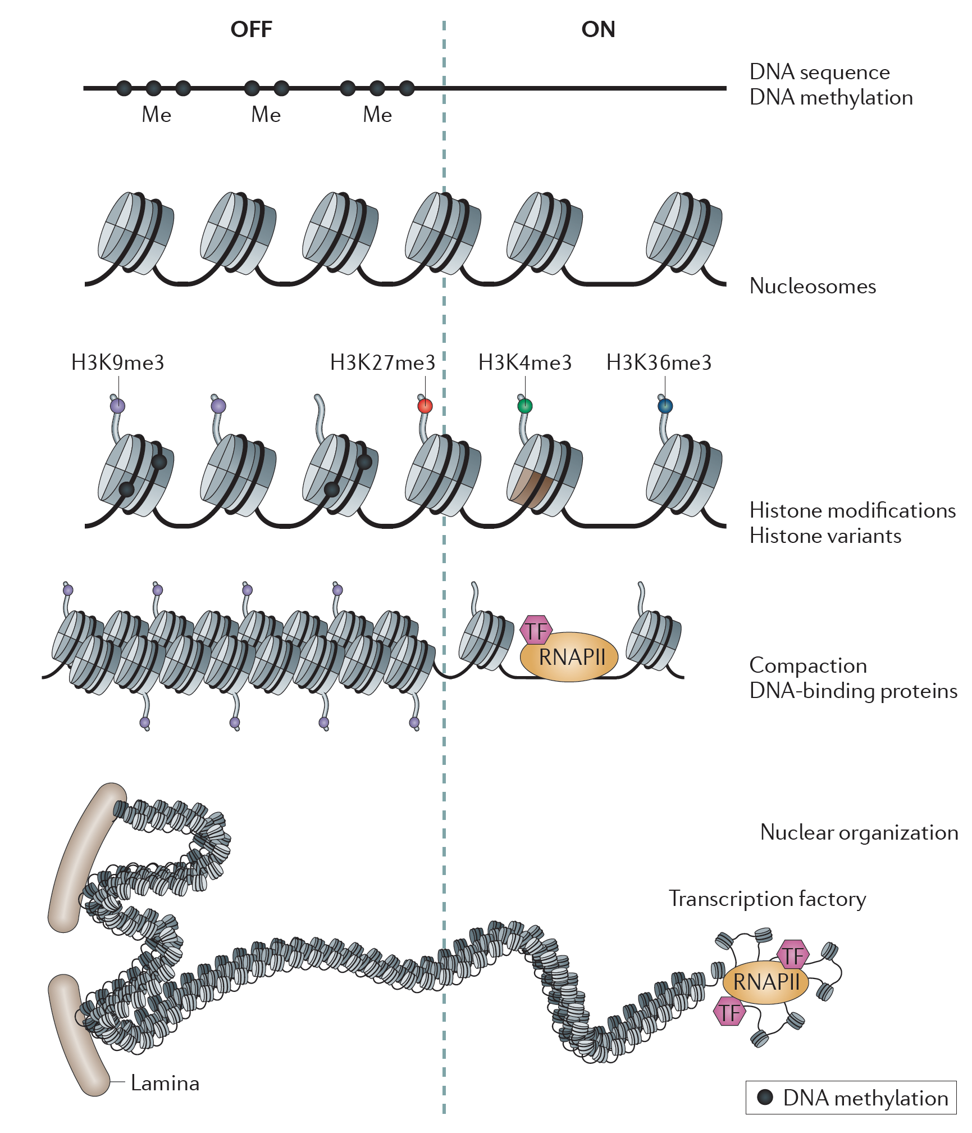
Layers of chromatin organization:
Zhou, Goren & Bernstein Nature Reviews Genetics 2010

Slide 9
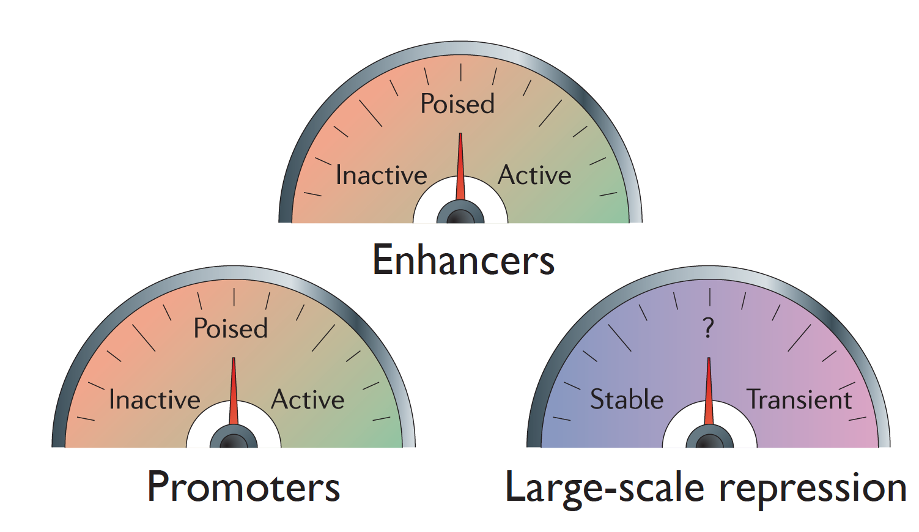
The dynamics of chromatin structure
Modified from Zho, Goren & Bernstein Nature Reviews Genetics 2010

Slide 10
Outline
Introduction to chromatin organization
ChIP-seq (Chromatin ImmunoPrecipitation) sequencing

Slide 11
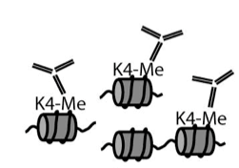
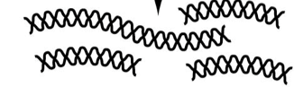
ChIP-seq
Map locations of proteins or protein variants bound to genomic DNA
Whole genome approach: Doesn’t require a priori knowledge
Targeting approach: identifies protein binding locations
Opened up a whole new field of chromatin structure
Immunoprecipitate fragmented chromatin
Purify DNA
Cross-linked cells
Sequence

Slide 12
Analysis of ChIP-seq data
Mikkelsen et al., Nature 2007

Slide 13

Analysis of ChIP-seq data
http://homer.ucsd.edu/homer/
Heinz & Benner et al., Mol Cell 2010

Slide 14
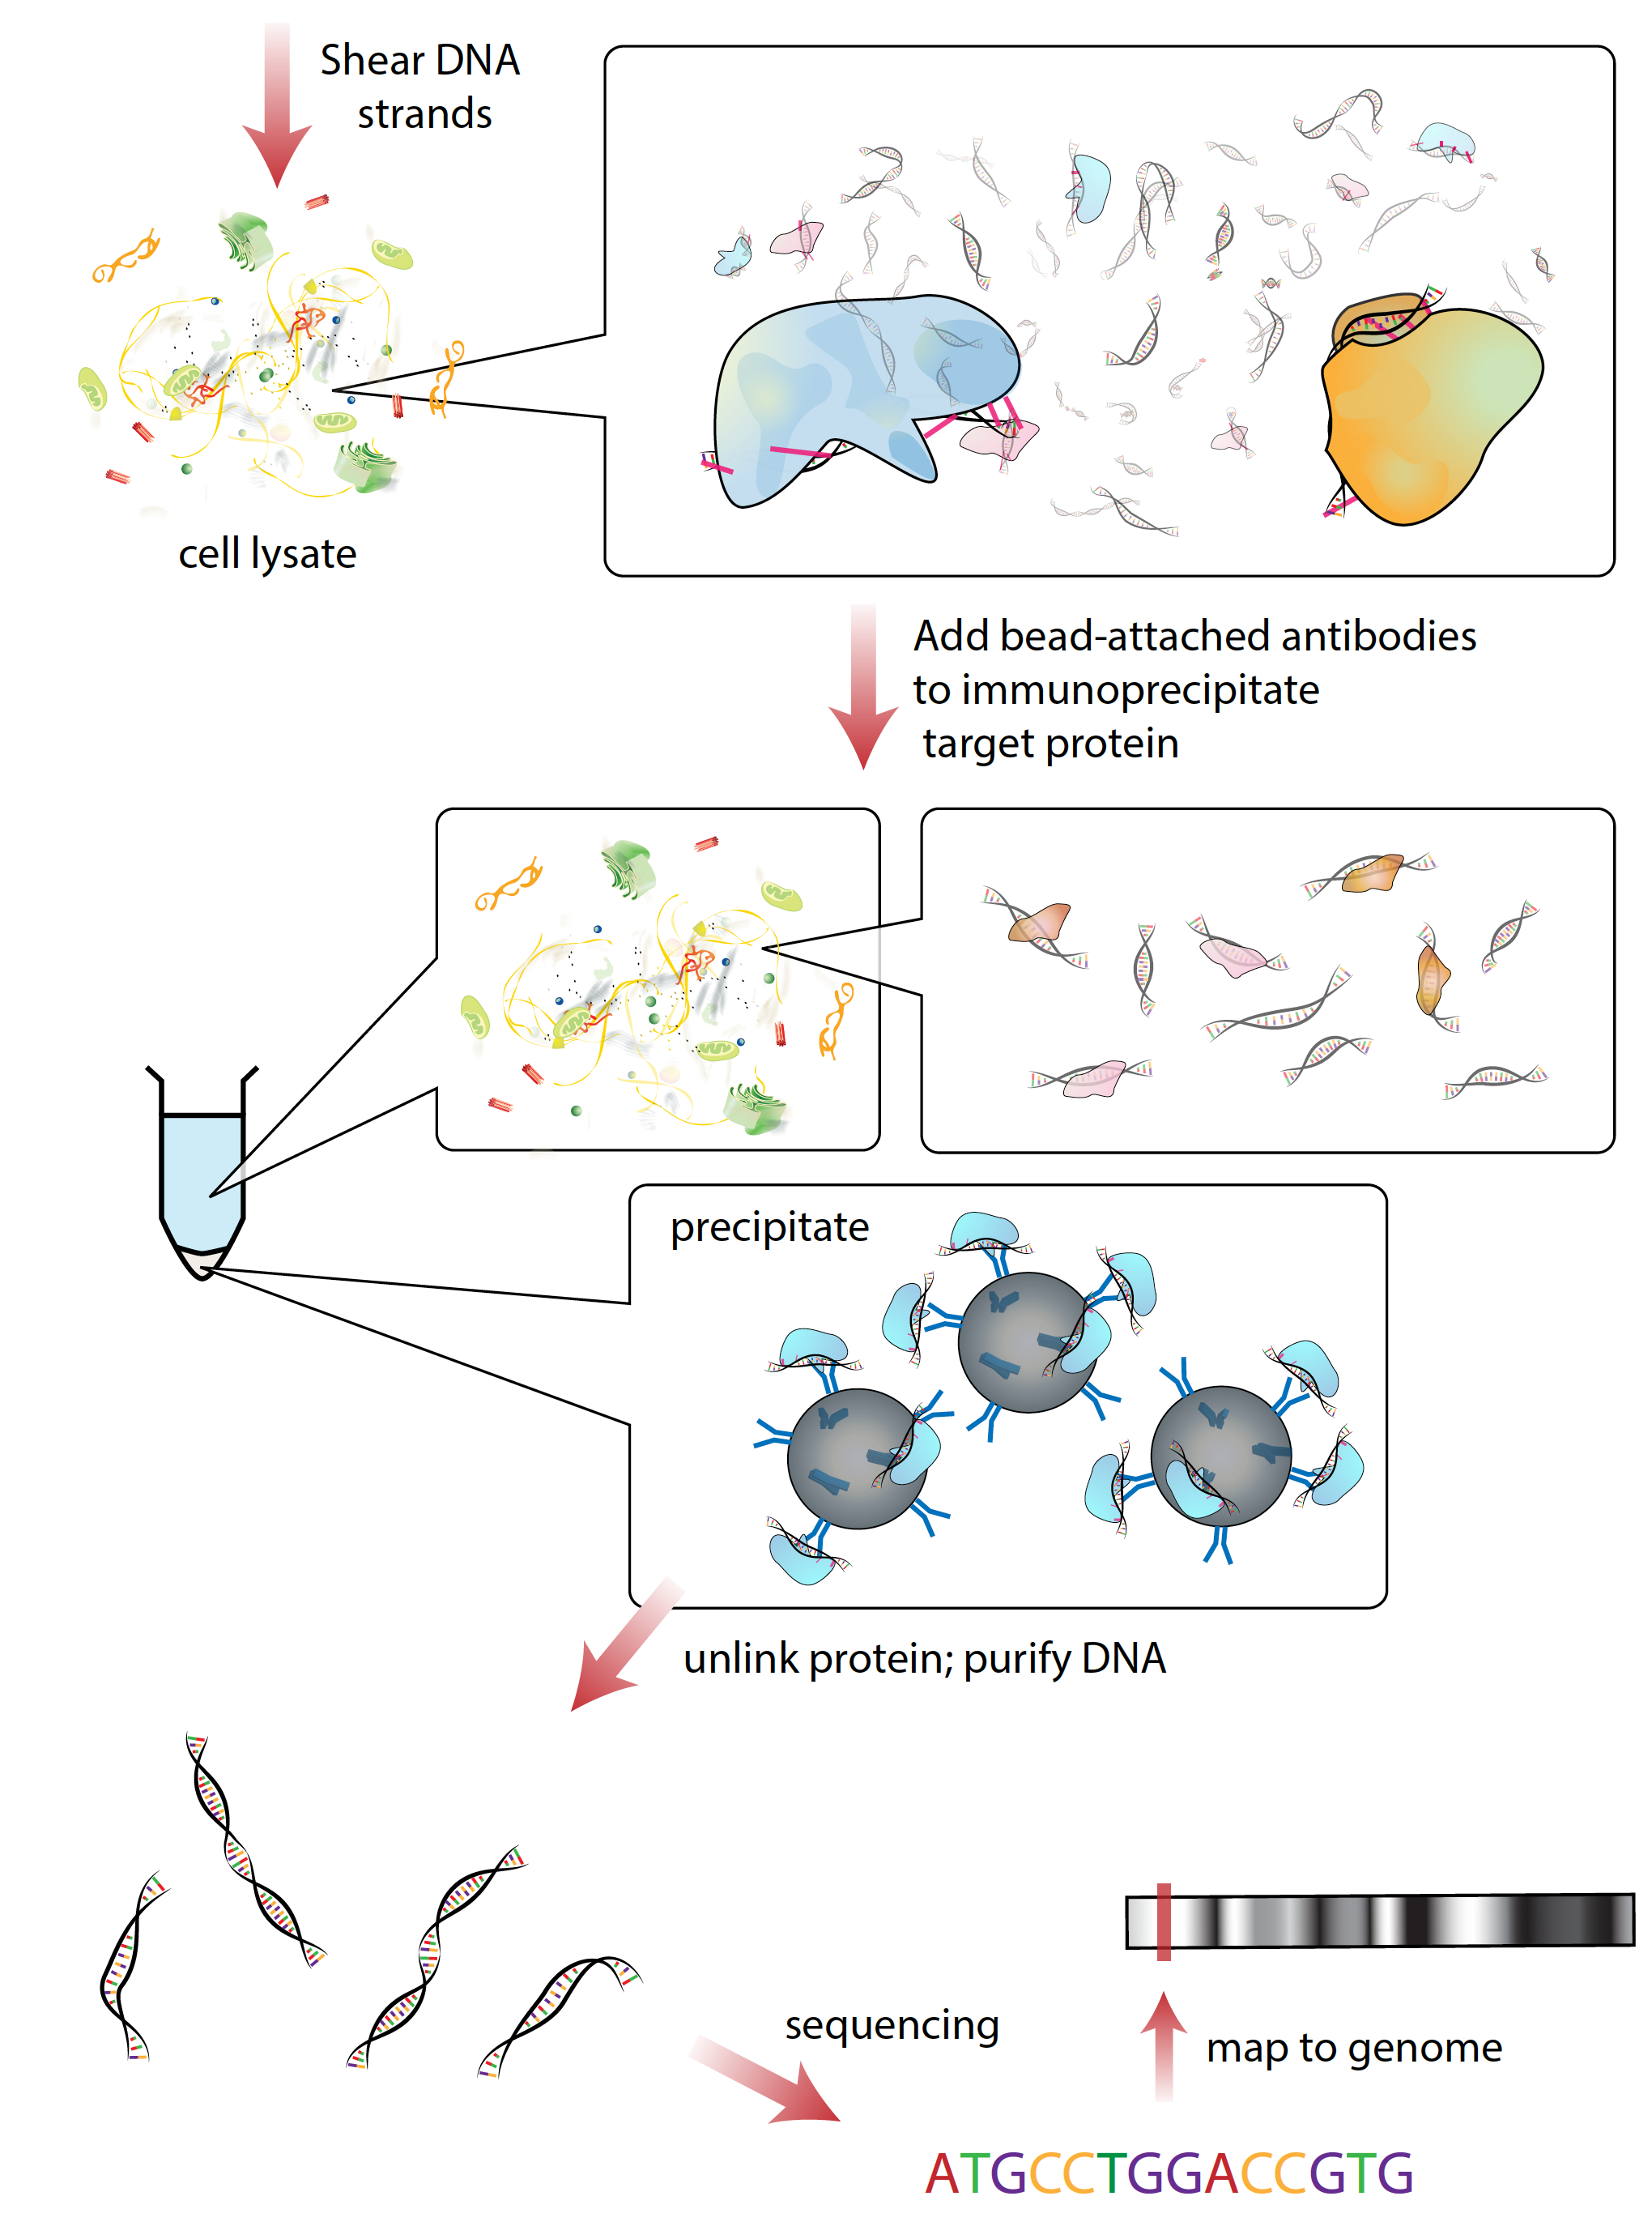
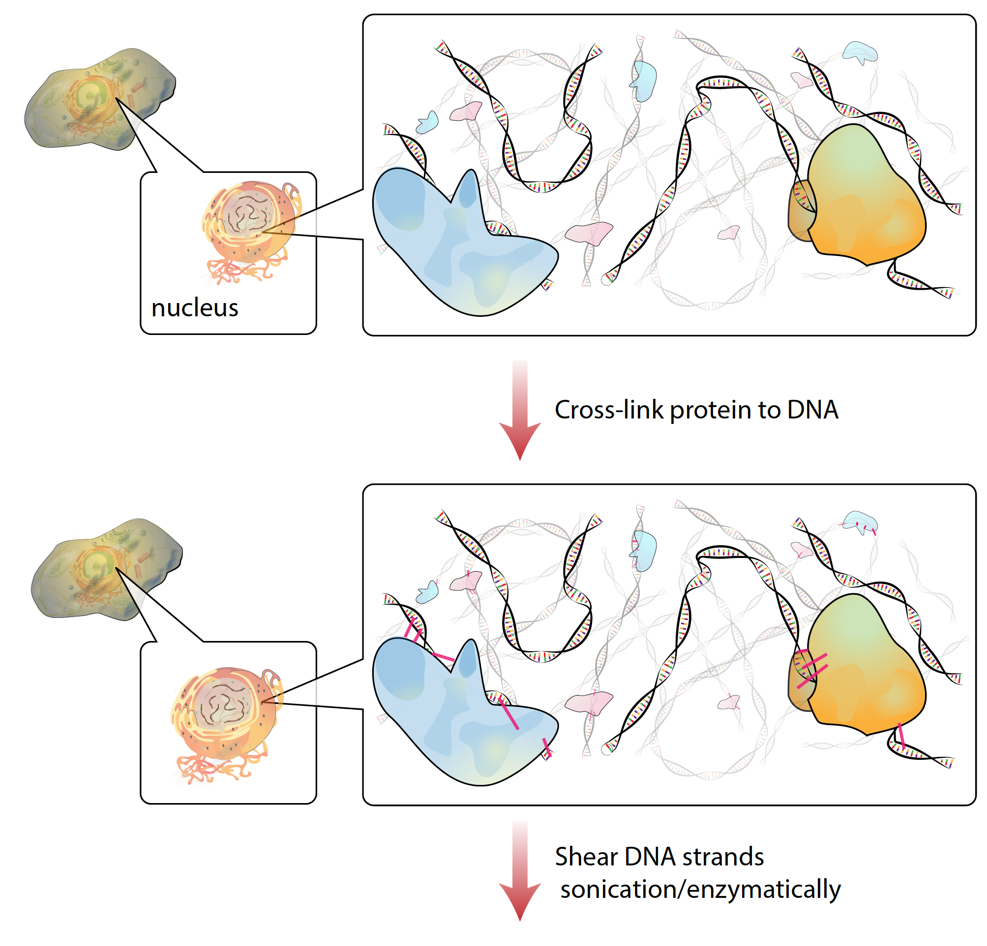
ChIP-seq – chart genomewide chromatin maps
Wikipedia.org

Slide 15
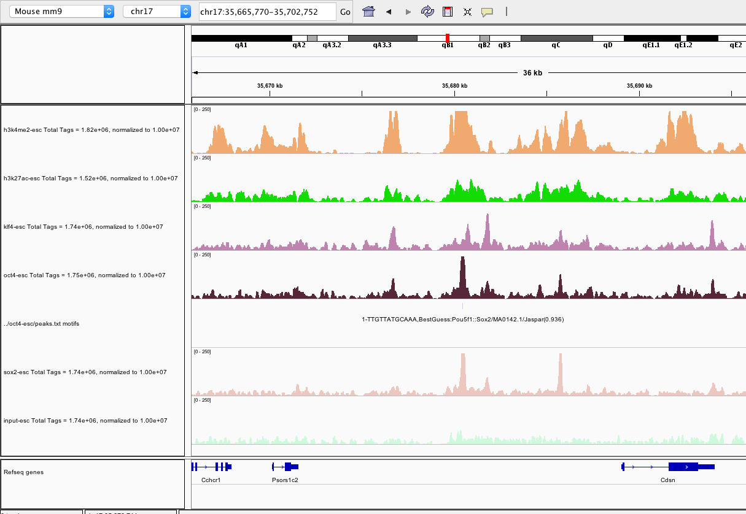
Visualization of ChIP-seq data
http://software.broadinstitute.org/software/igv/home

Slide 16


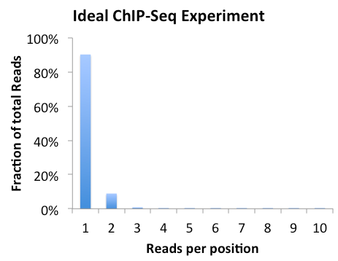
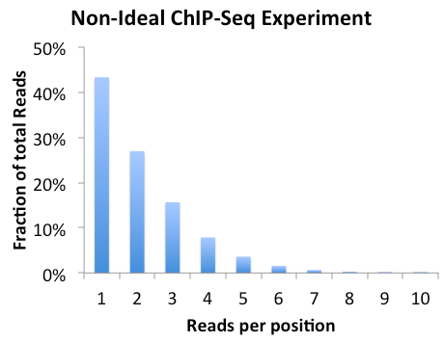
Quality Control: library complexity
Reads from most types of sequencing experiments should not be identical
If an experiment is “clonal”, there is a good chance that not enough starting material was used during library construction/over amplified
http://homer.ucsd.edu/homer/ngs/tagDir.html

Slide 17
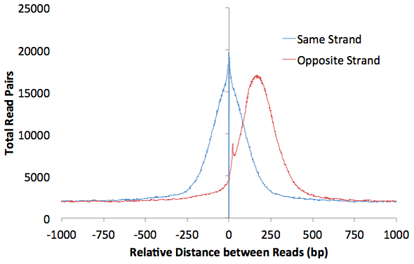
Quality Control: Autocorrelation
36 bp read
Use the distribution between reads to estimate the length of fragments cut-out for sequencing
150 bp ChIP Fragment
http://homer.ucsd.edu/homer/ngs/tagDir.html

Slide 18
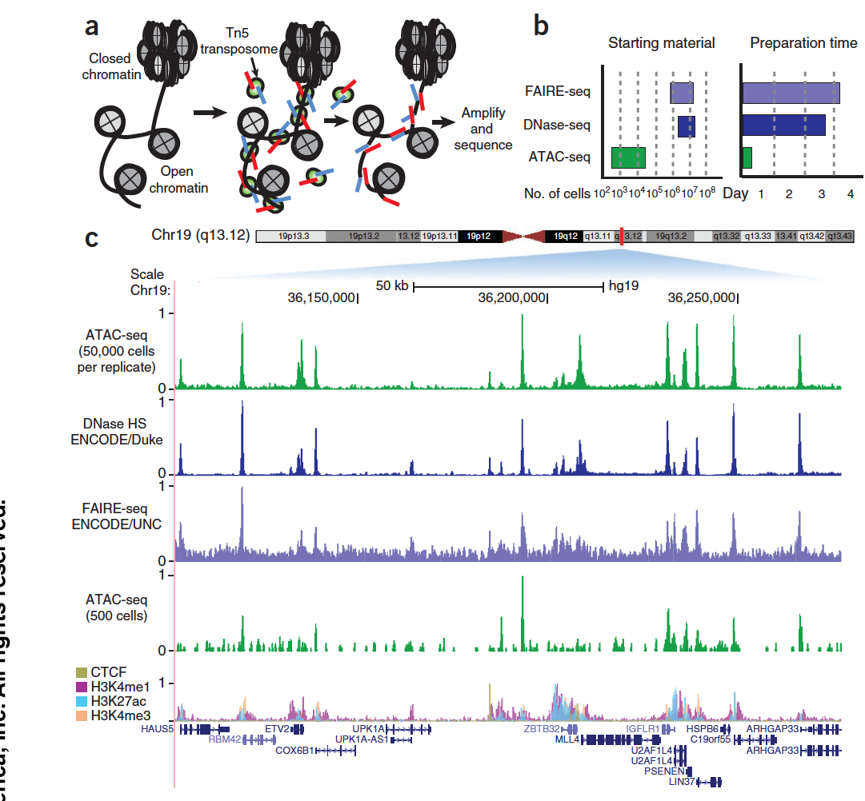
ATAC-seq:
assay for transposase-accessible chromatin
Buenrostro et al., Nature Methods 2013

Slide 19
Outline
Introduction to chromatin organization
ChIP-seq (Chromatin ImmunoPrecipitation) sequencing
Analysis of the genomic organization of DNA associated proteins

Slide 20
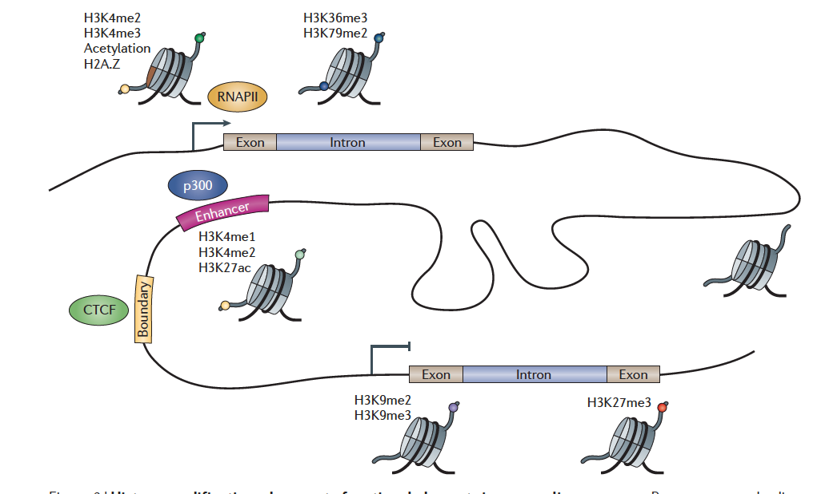
Histone modifications demarcate functional elements
Zhou, Goren & Bernstein Nature Reviews Genetics 2010

Slide 21
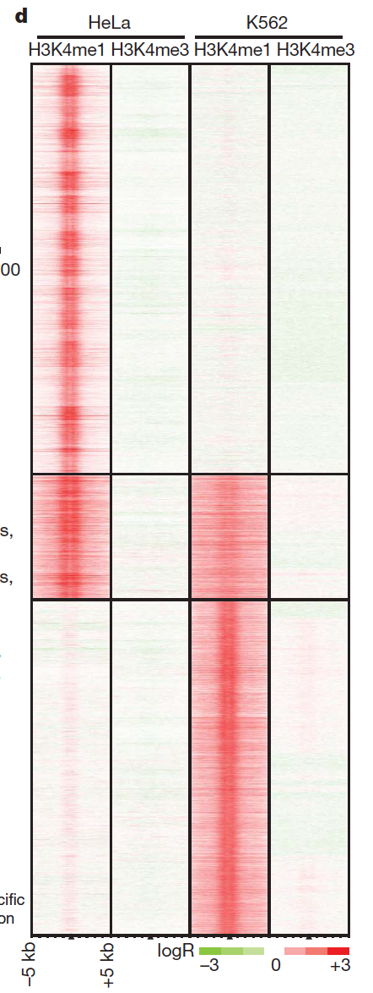
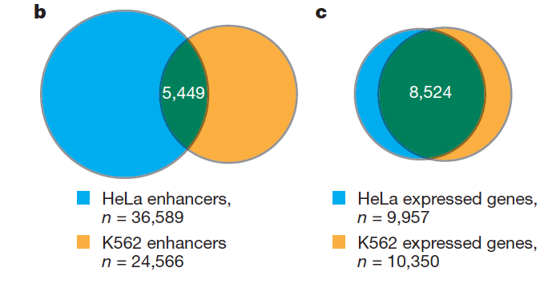
Annotation of putative enhancers
Heintzman, Hon & Hawkins et al., Nature 2009

Slide 22
The organization of histone modifications on genes
H3K4me3
H3K36me3
Beginning
(Promoter)
Gene body
End
A prototypical gene

Slide 23
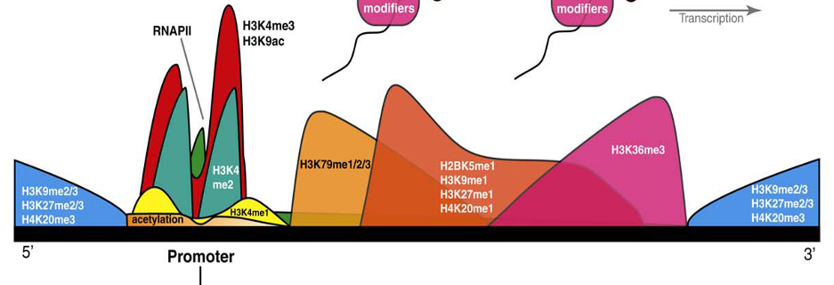
The organization of histone modifications on genes
Beginning
(Promoter)
Gene body
End
Barth et al., Trends in Bio Sci. 2010

Slide 24
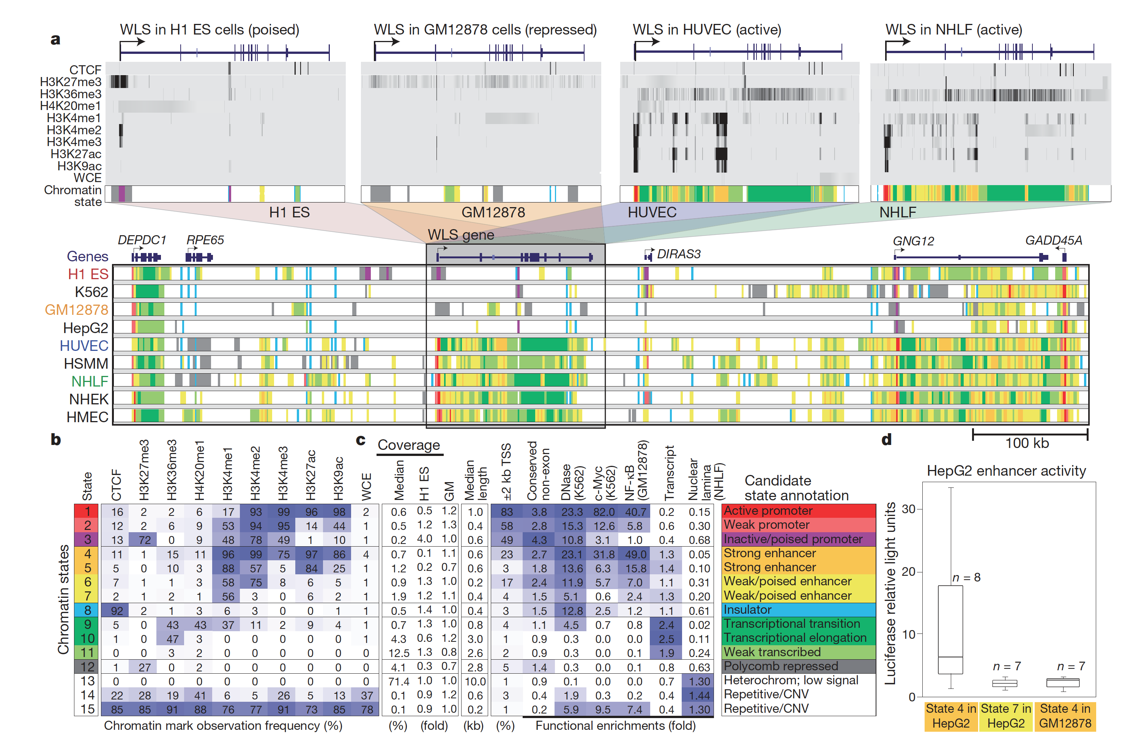
Chromatin States – Discrete Genomic Combinations of HMs
Ernst et al., Nature 2011

Slide 25
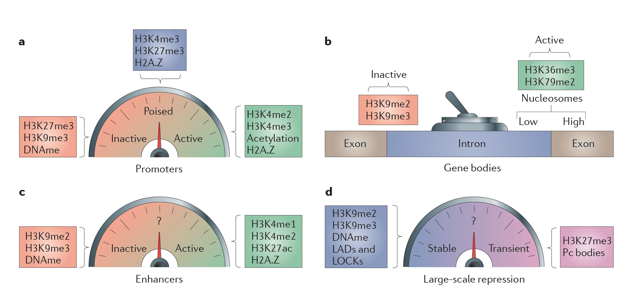
Fine-Tuning of genomic elements by histone modifications
Zhou, Goren & Bernstein Nature Reviews Genetics 2010

Slide 26
Outline
Introduction to chromatin organization
ChIP-seq (Chromatin ImmunoPrecipitation) sequencing
Analysis of the genomic organization of DNA associated proteins
An example study: Cooperative binding of TFs orchestrates reprogramming

Slide 27
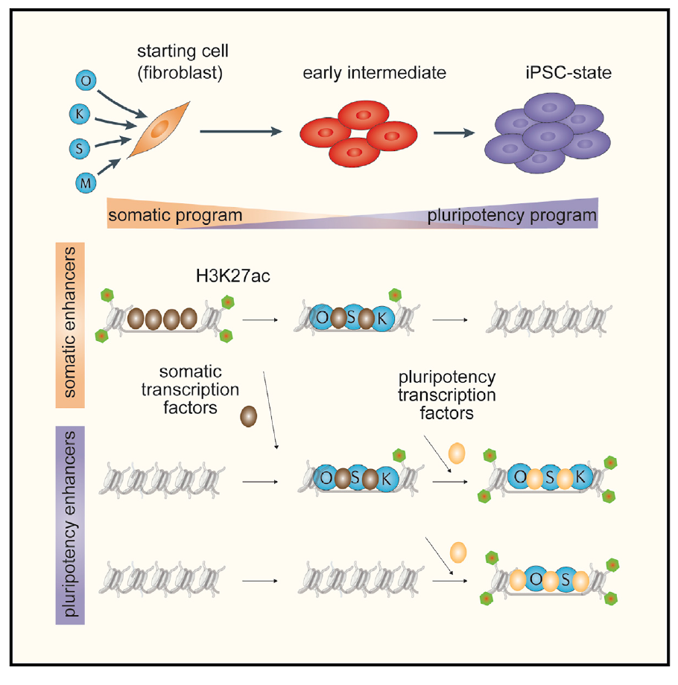
TF binding orchestrates reprograming
Chronis & Fiziev et. al Cell 2017

Slide 28
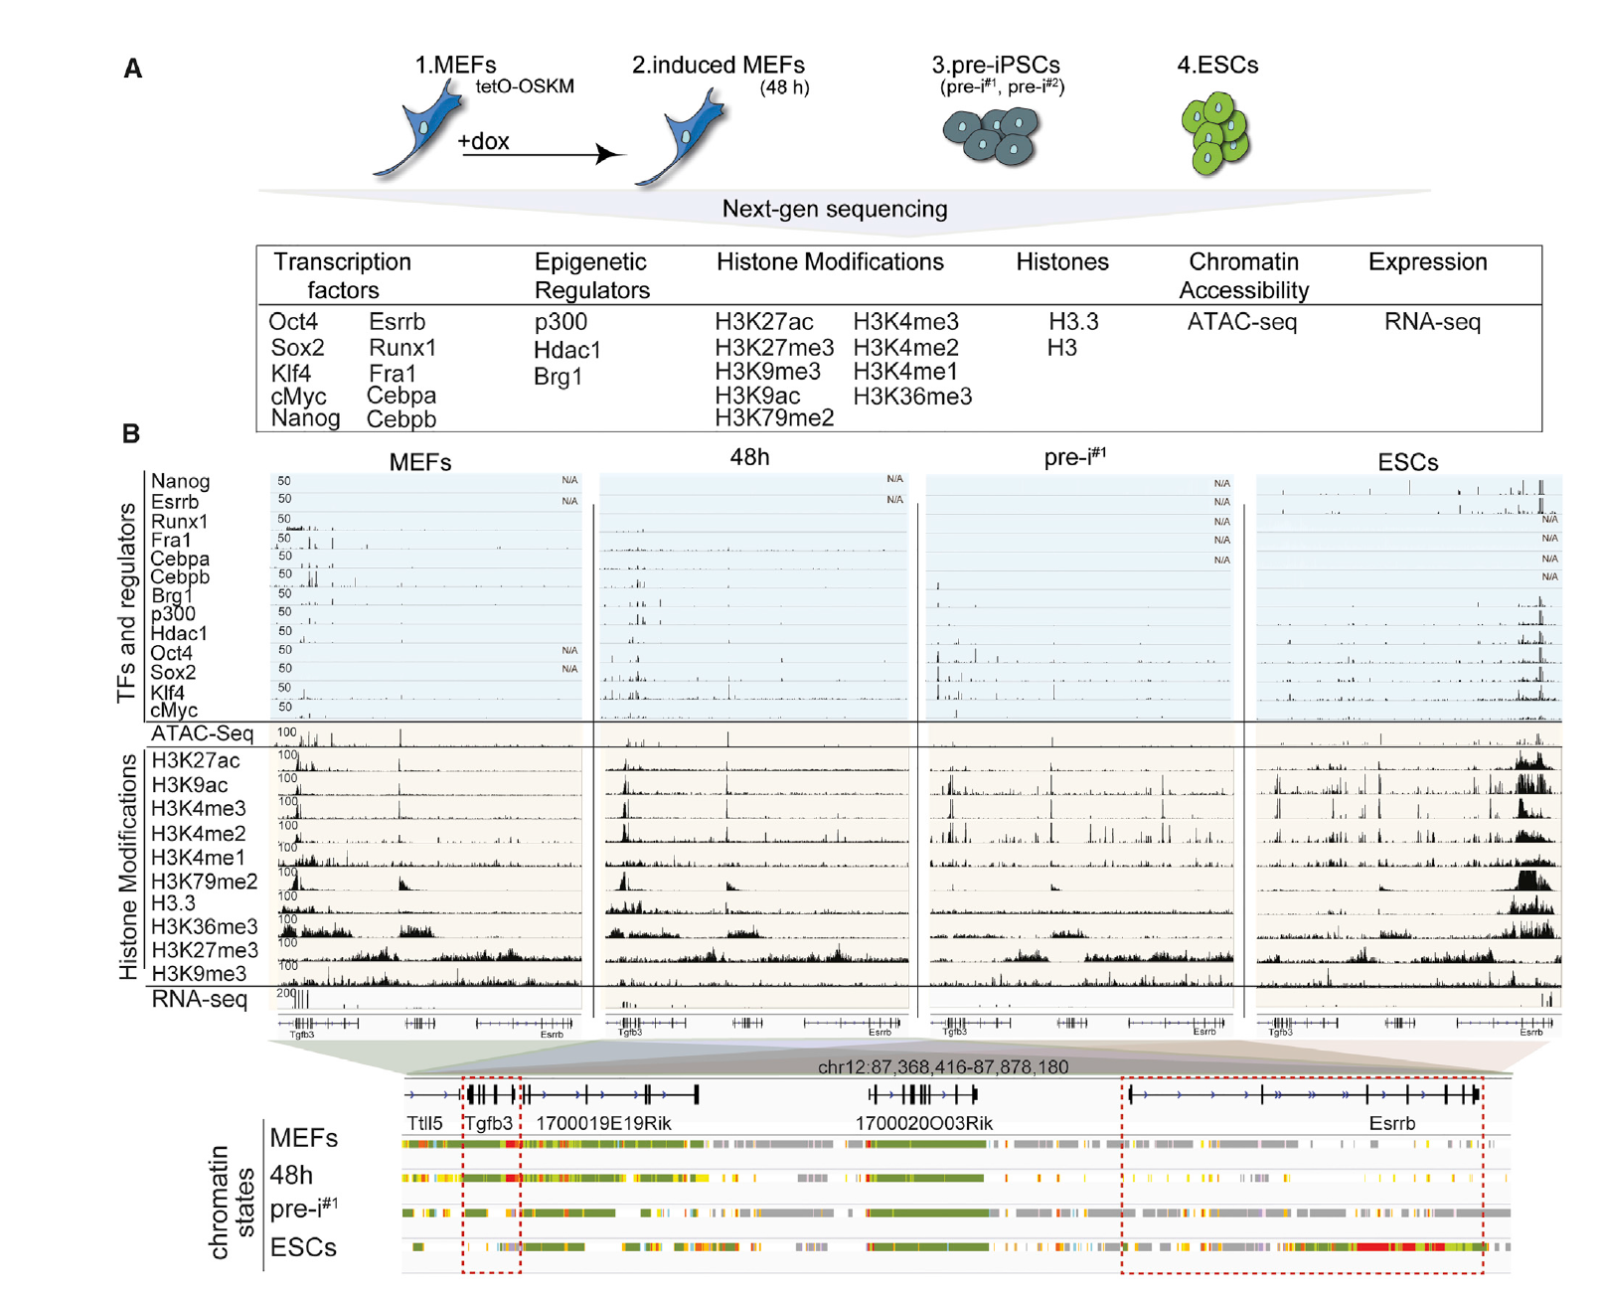
TF Binding during reprograming stages
Chronis & Fiziev et. al Cell 2017

Slide 29
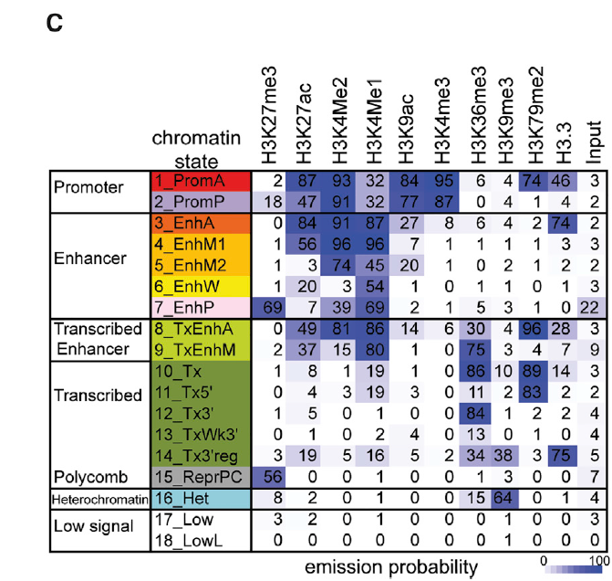
TF Binding during reprograming stages
Chronis & Fiziev et. al Cell 2017

Slide 30
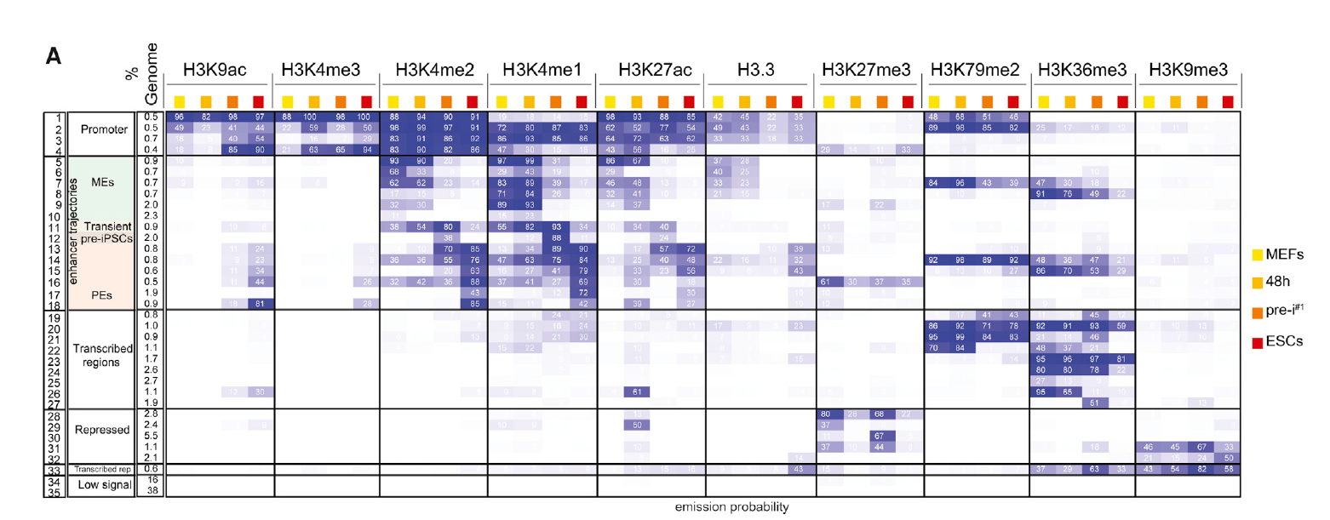
Enhancer reorganization during reprograming stages
Chronis & Fiziev et. al Cell 2017

Slide 31
Outline
Introduction to chromatin organization
ChIP-seq (Chromatin ImmunoPrecipitation) sequencing
Analysis of the genomic organization of DNA associated proteins
An example study: Cooperative binding of TFs orchestrates reprogramming
Future directions

Slide 32
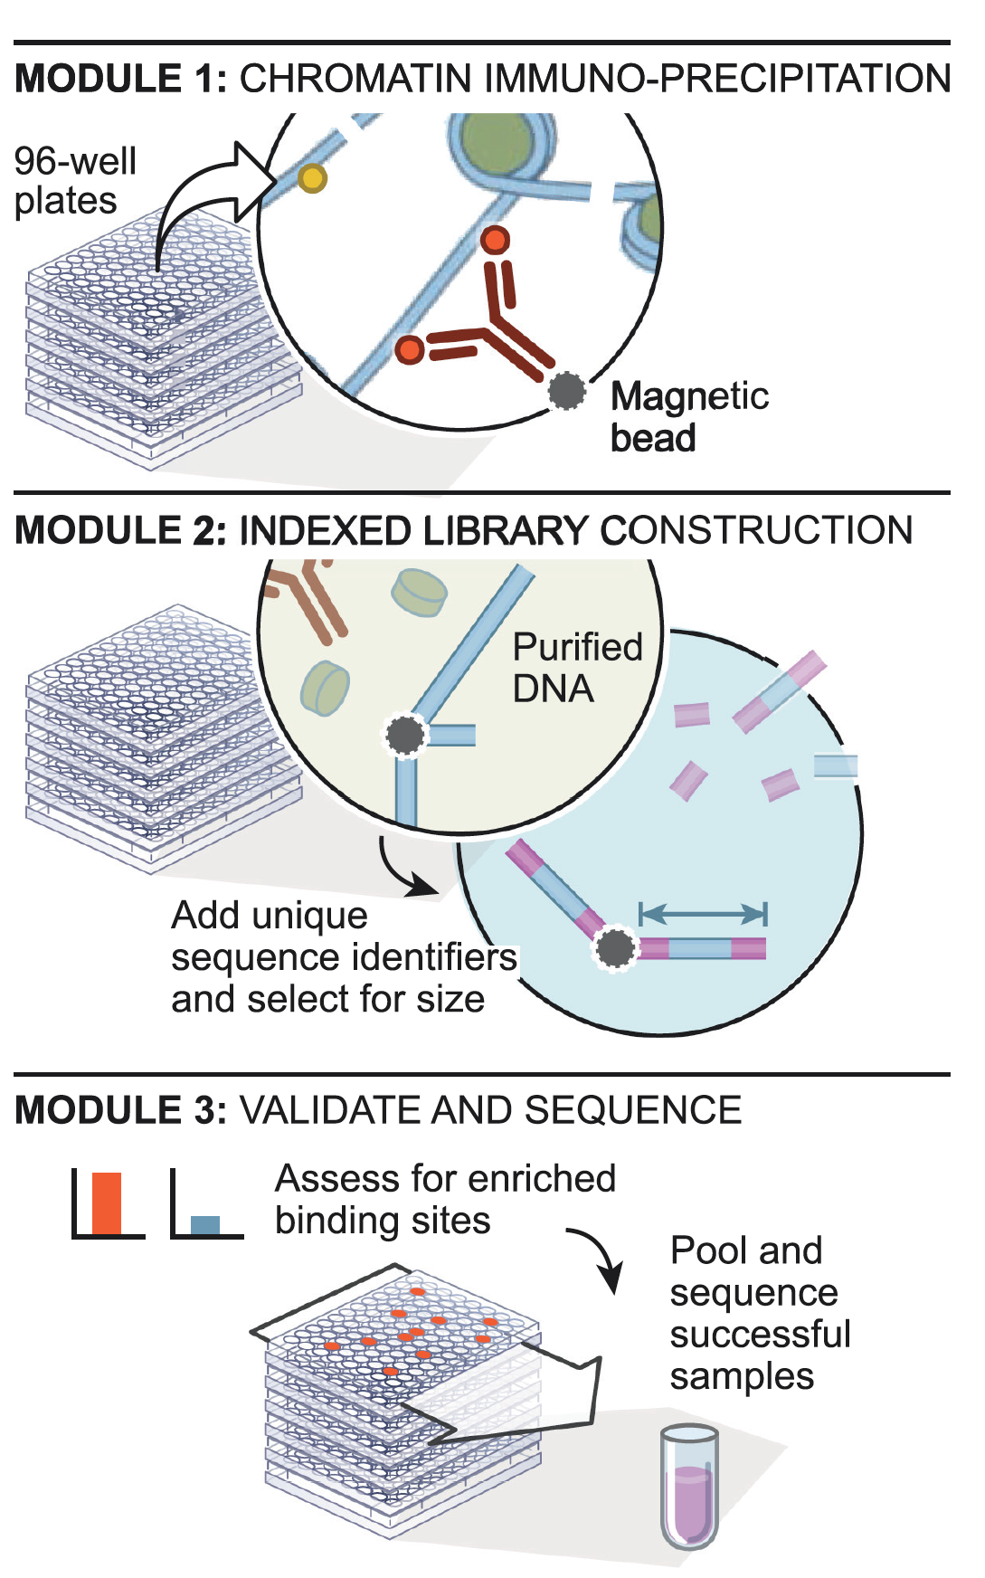
Robust scalable automated ChIP-seq
Garber & Yosef et al Mol Cell 2012

Slide 33
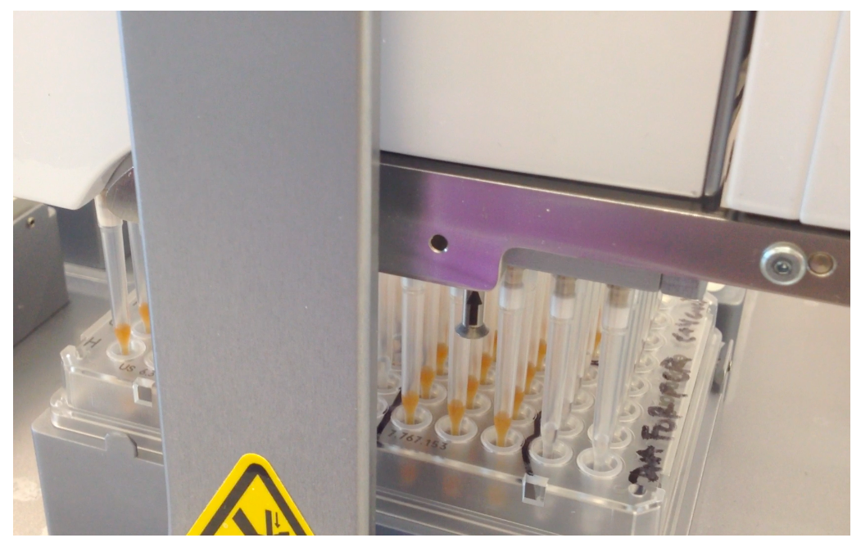
Establishment of robustness via automation

Slide 34
ChIP-seq process
Prep cells
Chromatin ImmunoPrecipitation
Cross-link
(Formaldehyde)
Freeze
pellet
Cells
Lyse
Shear
wash
thaw
Elute
12 washes
Ab bind
incubate
dilute
Library
construction
Prepped Abs
WCE
End repair
A base tail
Ab
QC
Size exclusion
& cleanup
Ligate barcoded adapters
Protein A,G
mag beads
(Sequence)
PCR
amplification
Size exclusion
& cleanup
DNA sequencing
QC (several)
DNA sequencing (several options)
Analysis

Slide 35
ChIP-seq process: Automated
Prep cells
Chromatin ImmunoPrecipitation
Cross-link
(Formaldehyde)
Freeze
pellet
Cells
Lyse
Shear
wash
thaw
Elute
12 washes
Ab bind
incubate
dilute
Library
construction
Prepped Abs
WCE
End repair
A base tail
Ab
QC
Size exclusion
& cleanup
Ligate barcoded adapters
Protein A,G
mag beads
(Sequence)
PCR
amplification
Size exclusion
& cleanup
DNA sequencing
QC (several)
DNA sequencing (several options)
Analysis
Notes:
From cells to seq, many steps. We have the whole thing automated. All these steps were done manually. Now none is.

Slide 36
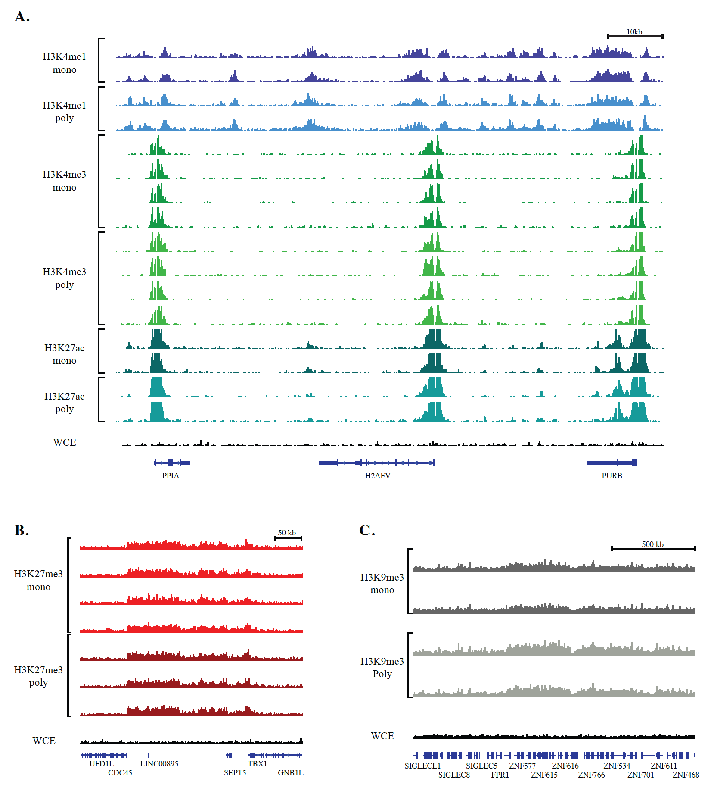
Systematic comparison of monoclonal vs polyclonal antibodies for ChIP-seq
Busby, et. al. Epigenetics & Chromatin, 2016

Slide 37
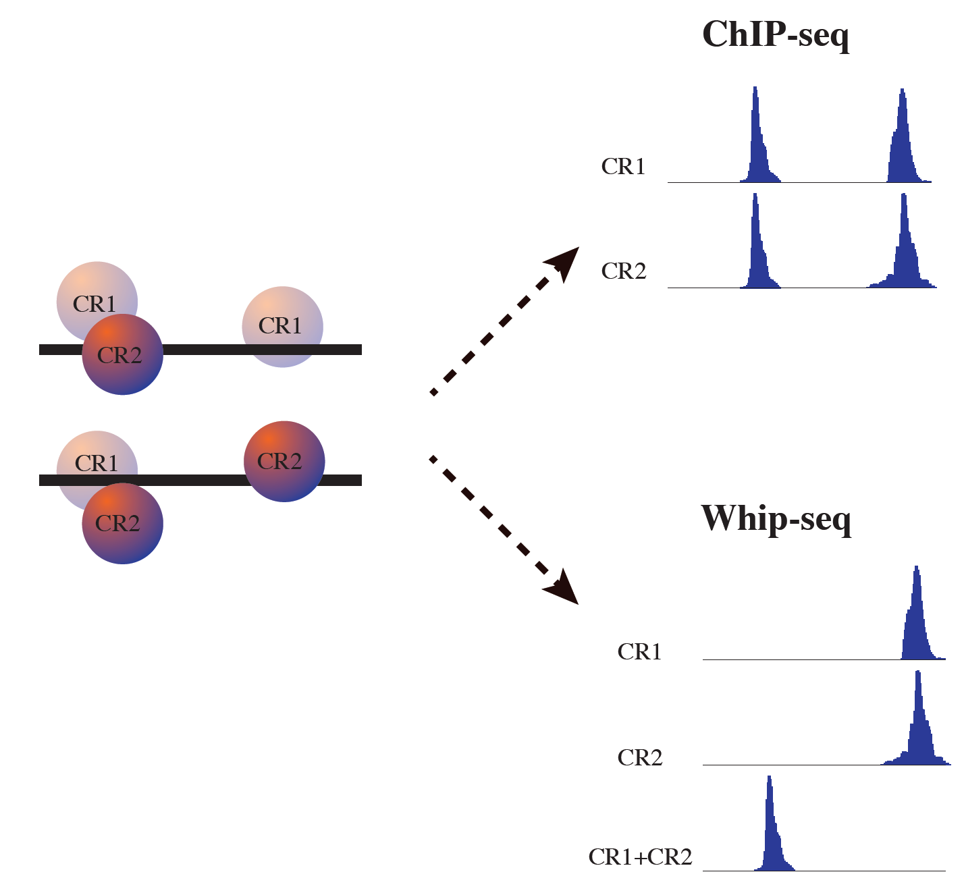
Whip-seq – without IP

Slide 38
Questions ?

